Slide 1
Outline
Introduction
Skill & Talent
Research Experience
01
02
03
Industry Research
Future Research Interests
04
05

Slide 2
Introduction
TIANQI YU
Birth: 1997/11/20
Birthplace: Harbin
Current Location: Nanjing
2016 - 2020
Mobileye
2021 - 2022
DiDi
2023 - Current
TJUT
2019
UoM
2022
China Unicom
TOEFL 2018
GRE 2019
TIANJIN VICO 2020

Slide 3
Introduction
01
Exploration
Why PhD
02
Curiosity
03
Opportunities

Slide 4
Skills & Talent
CV
01
NLP
02
LLM
03
Object Detection
Multi-Object Tracking
MMLM
Text Summarization
Text Classification
Semi-supervised Learning
Pre-training
Fine-Tuning
Inference, RAG
Backend
04
Others
05
Certificate
06
Spring Boot, Spring MVC
Django, Flask, FastApi
Docker
Kubernetes
Cloud Production
AWS Cloud Practitioner
Artificial Intelligence Engineer Senior - MIIT

Slide 5


Research Experience
Paper
01
Large Language Models in Intelligent Service System, Ticket Classification:
Evaluation, Analysis and Distillation
Research Project
02
Z3 Rule-Based Multi-Step Reasoning: DAG-Driven Dataset Generation
With Variable and Semantic Constraints

Slide 6
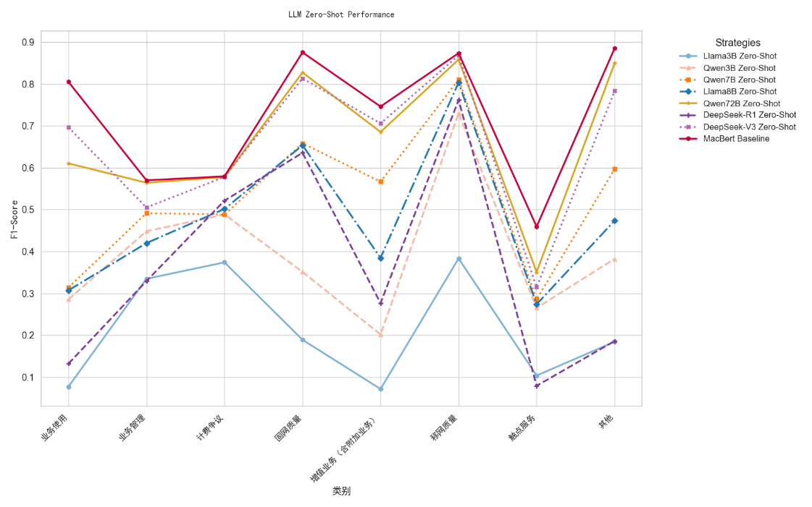
Research Experience 1
Large Language Models in Intelligent Service System: Evaluation, Analysis and Distillation
What we do?
Eval multiple popular LLM on domain-specific task, telecom ticket classification
Conduct an eval pipeline integrates quantitative metrics and task-specific requirements
Analyze different prompt strategies on industrial dataset
Ablation Study on different prompt strategies
Explore knowledge distillation and re-eval
Why we do this?
Huge gap between academic & industrial dataset
Rapid evolution of LLM capabilities
Clarifying LLMs in telecom customer service
What we conclude
LLM+zero-shot+plain prompt doesn’t work
Few-shot improves accuracy under limited samples, but still has limitation
Mutual Exclusion + Boundary Condition + Few-shot work!
Distilling small-parameter LLM with few hundreds data surpasses ten billions LLM

Slide 7
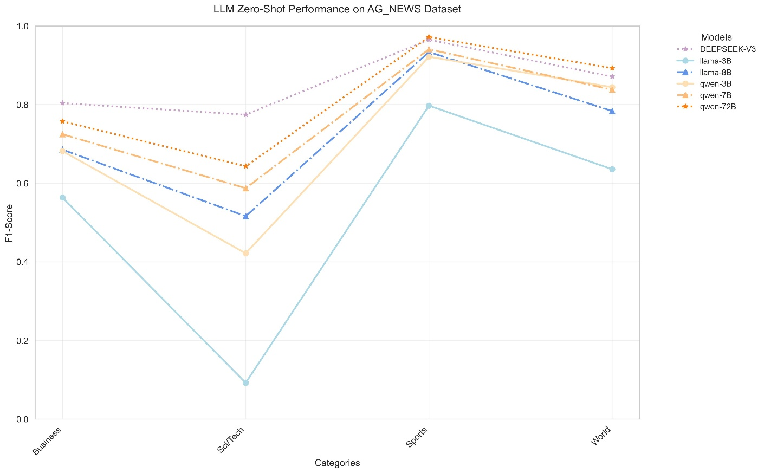
Research Experience 1
Large Language Models in Intelligent Service System: Evaluation, Analysis and Distillation

Slide 8
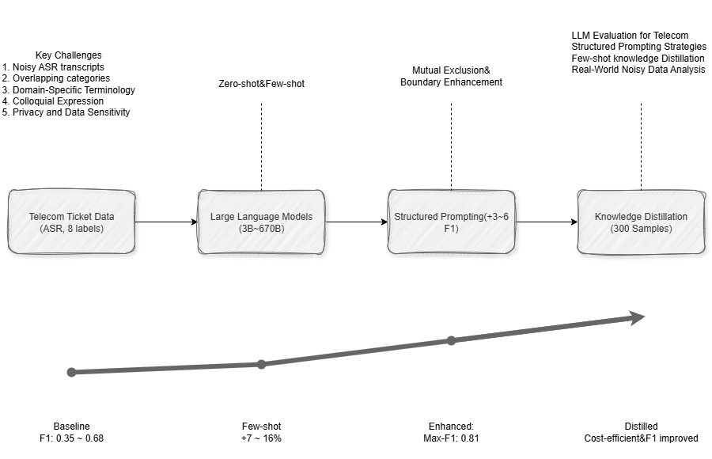
Research Experience 1

Slide 9
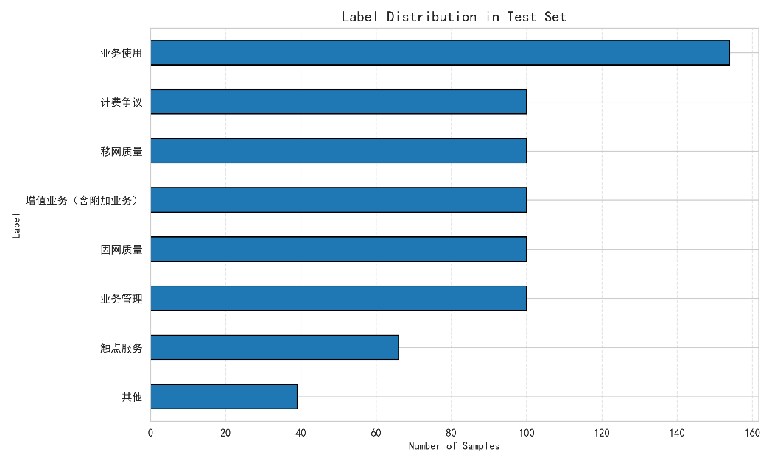
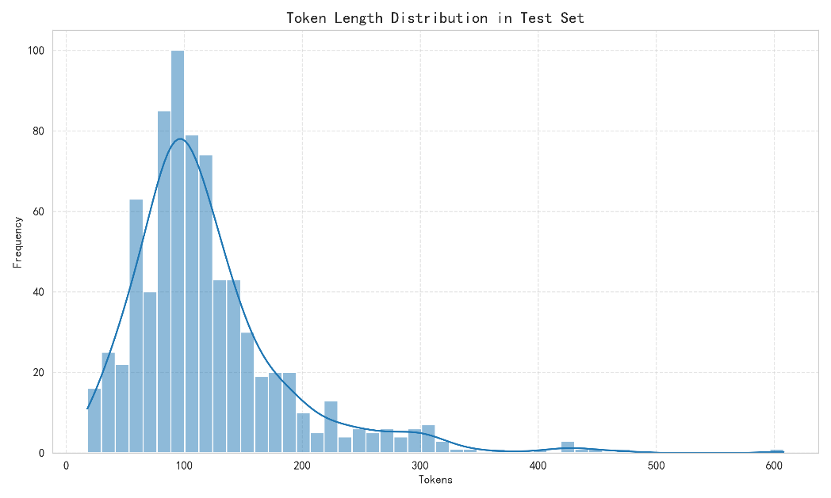
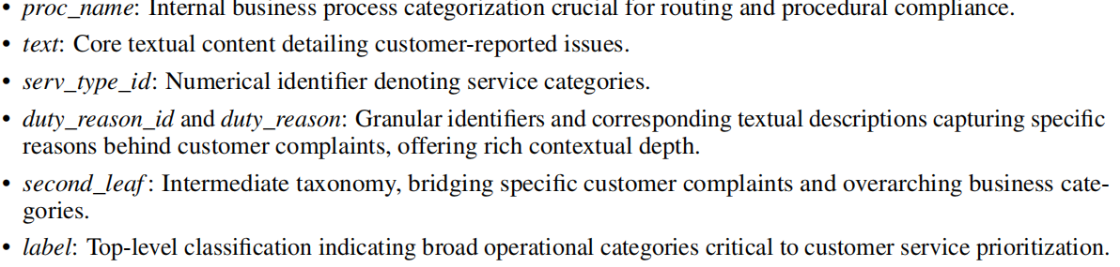
Research Experience 1

Slide 10
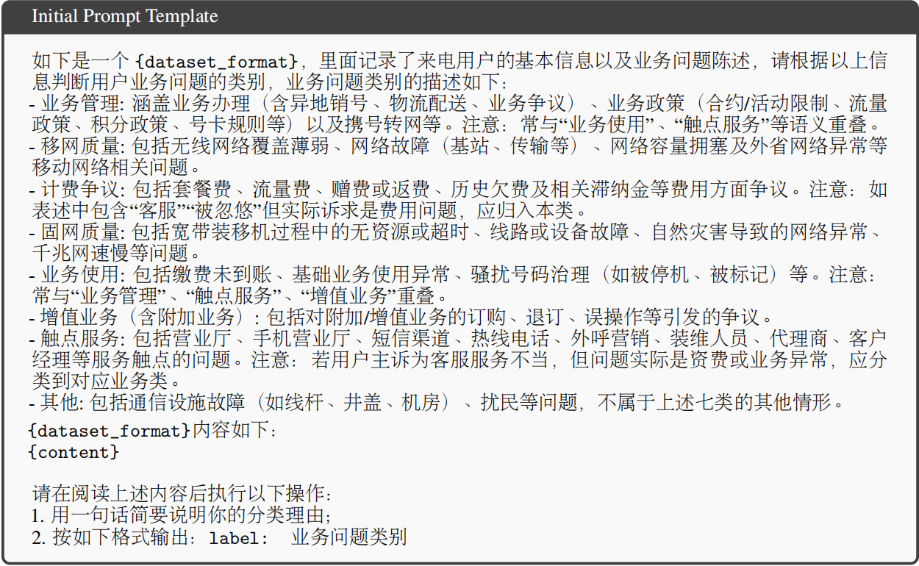
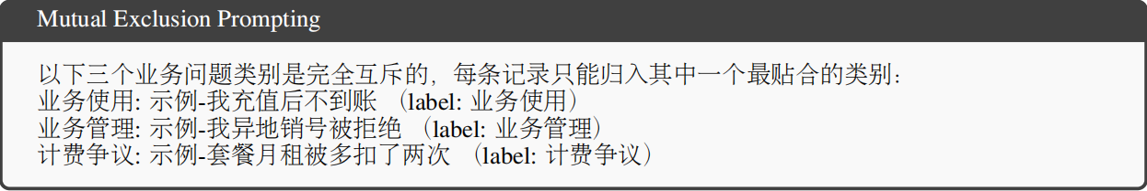
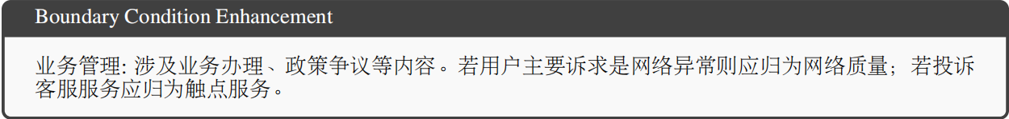
Research Experience 1

Slide 11
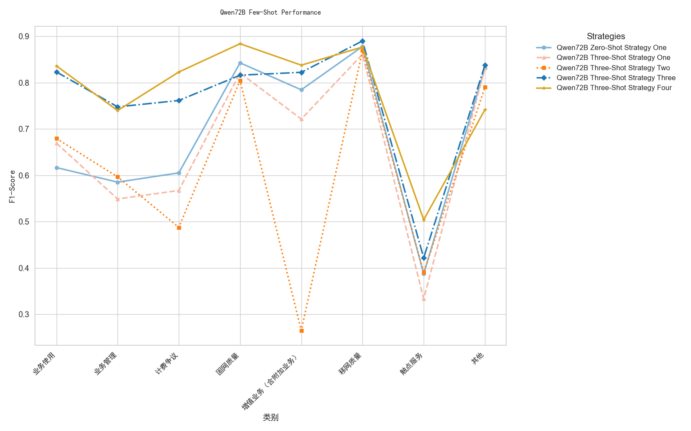
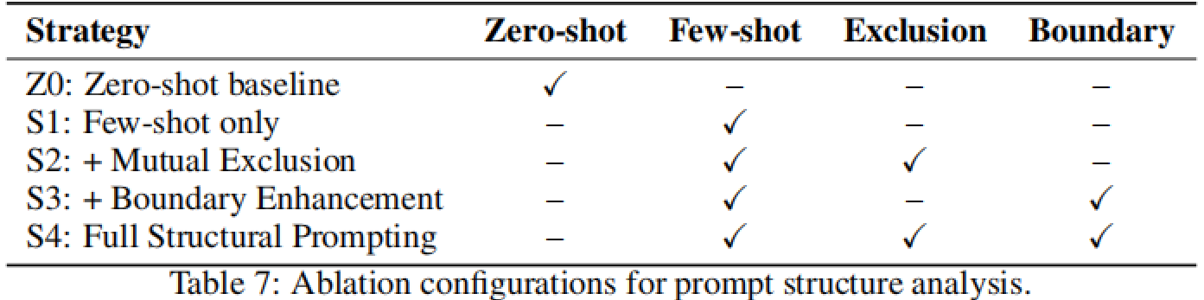
Research Experience 1

Slide 12
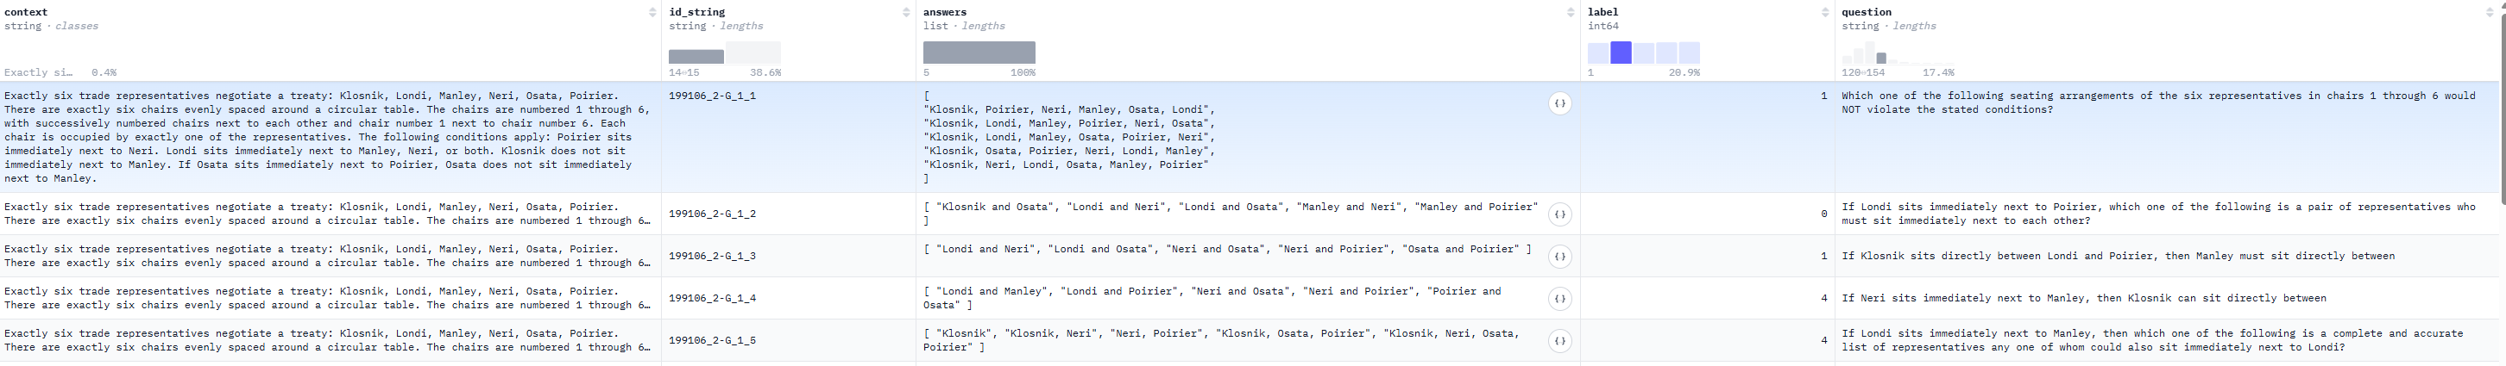
Research Experience 2
Z3 Rule-Based Multi-Step Reasoning: DAG-Driven Dataset Generation With Variable and Semantic Constraints
What we do?
Produced LSAT-style logical reason datasets for LLM training and eval
New Method: DAG-based, Validator, Safety Check, Distractor and Gibberish
Why we do this?
Limitations in Reasoning
Training Data Quality Issues
Controllability and Interpretability
Commonsense Ability in LLM
What is it like?
AR-LSAT

Slide 13
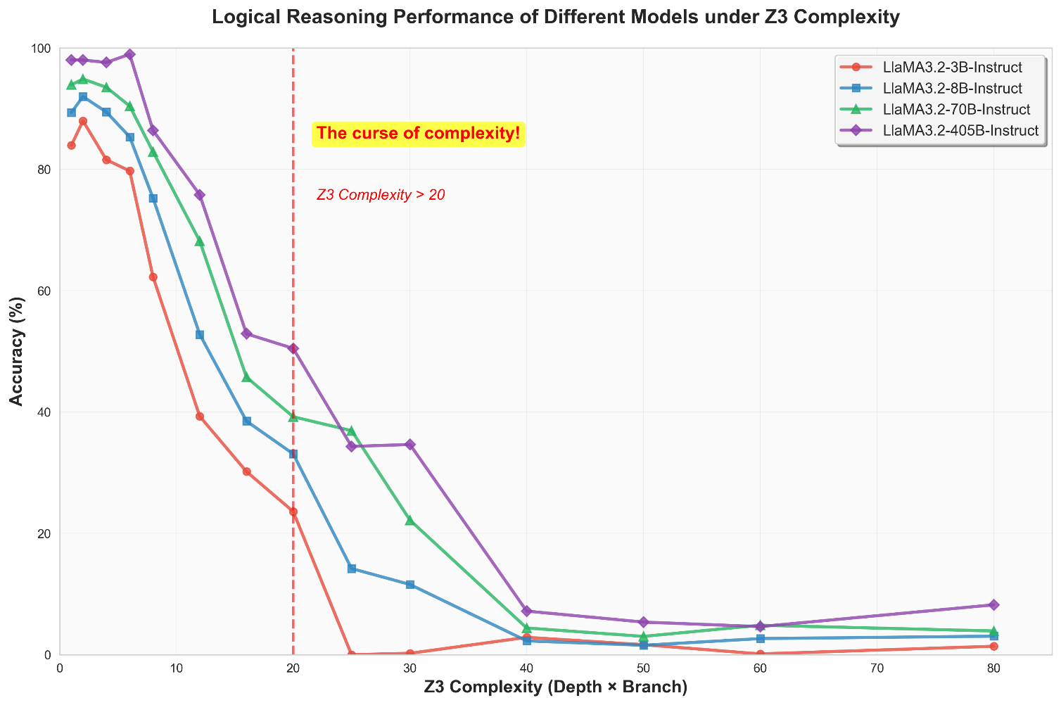
Research Experience 2
GPT-4o
64.2% in FOLIO
33% in LSAT-logic games
On LogiGLUE, GPT-4o achieves 73.59% on deductive reasoning
But only 31.55% on inductive tasks

Slide 14
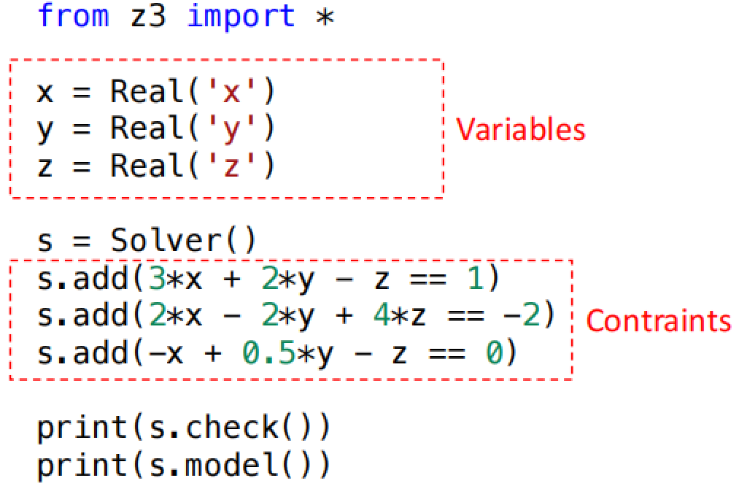
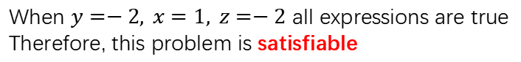
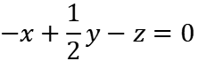
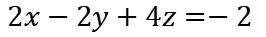

Research Experience 2
Z3 Theorem Prover, is a satisfiability modulo theories(SMT) solver developed by Microsoft
$$3x+2y−z=1$$
When $y=−2, x=1, z=−2$ all expressions are true
Therefore, this problem is satisfiable
$$2x−2y+4z=−2$$
$$−x+\frac{1}{2}y−z=0$$

Slide 15
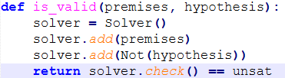
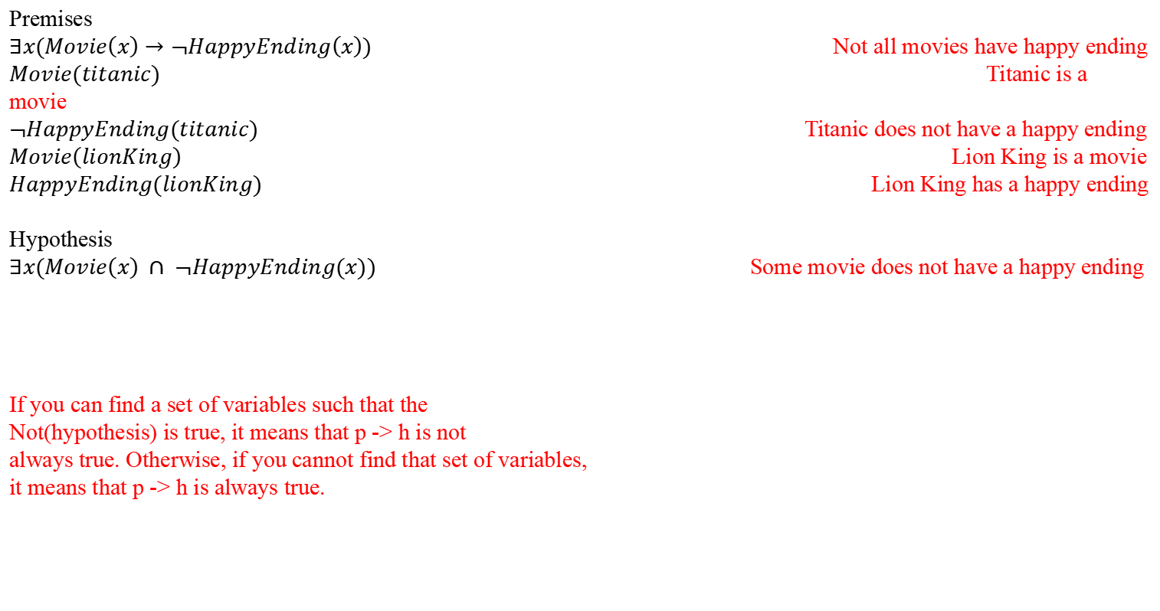
Research Experience 2
Premises
$∃x(Movie\left(x\right)→¬HappyEnding\left(x\right))$ Not all movies have happy ending
$Movie(titanic)$ Titanic is a movie
$¬HappyEnding(titanic)$ Titanic does not have a happy ending
$Movie\left(lionKing\right)$ Lion King is a movie
$HappyEnding(lionKing)$ Lion King has a happy ending
Hypothesis
$∃x(Movie\left(x\right) ∩ ¬HappyEnding(x))$ Some movie does not have a happy ending
If you can find a set of variables such that the
Not(hypothesis) is true, it means that p -> h is not
always true. Otherwise, if you cannot find that set of variables,
it means that p -> h is always true.

Slide 16
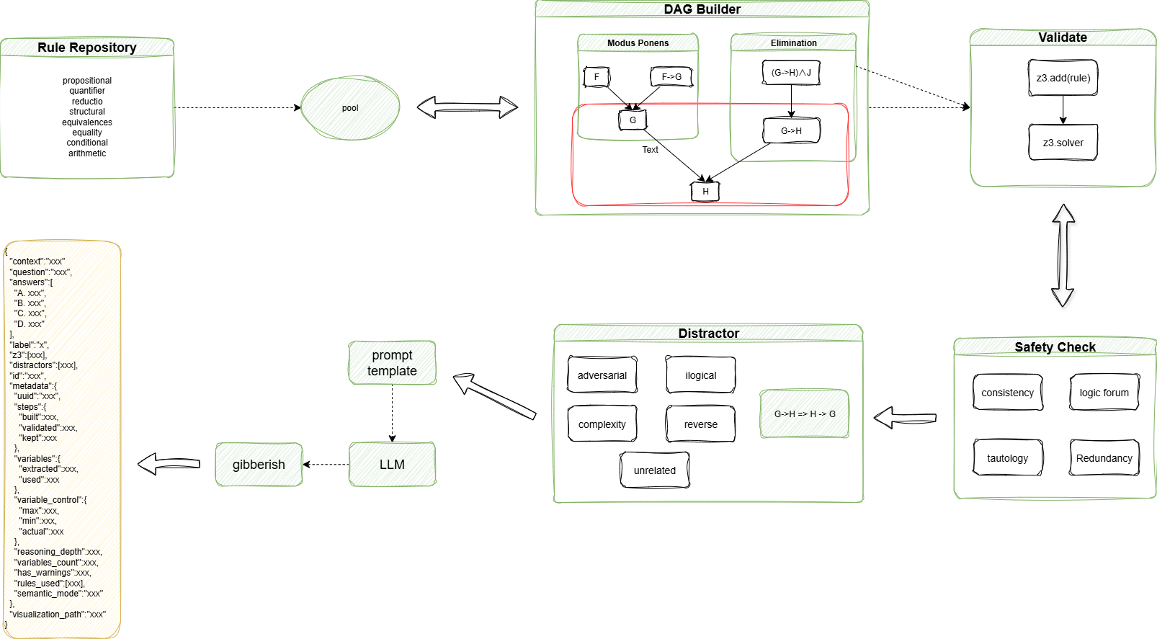
Research Experience 2

Slide 17
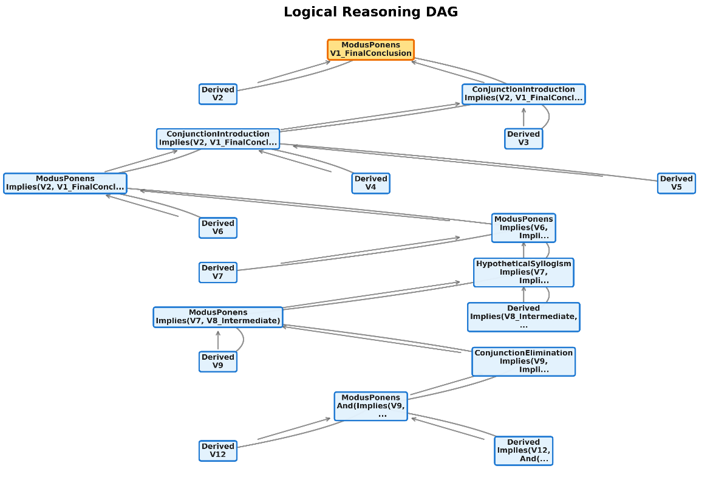
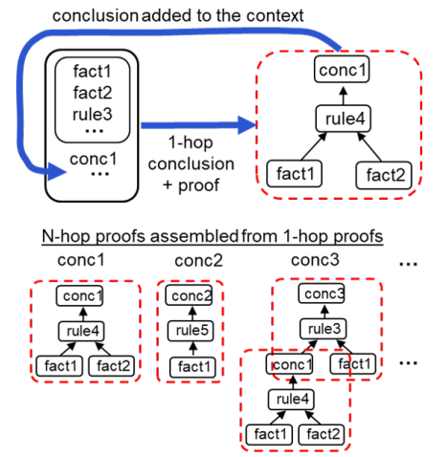


Research Experience 2

Slide 18
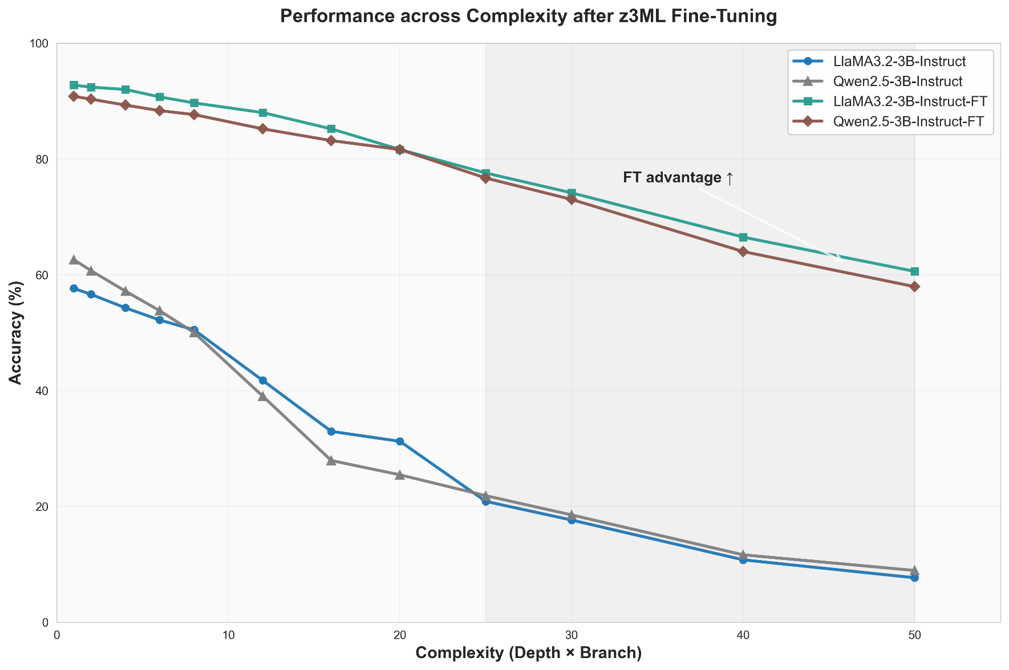
Research Experience 2
1000 sample data, including:
Biconditional Elimination
Conjunction Introduction
Conjunction Elimination
Disjunction Introduction
Hypothetical Syllogism
Modus Ponens
Transitivity
Universal Instantiation

Slide 19


Industry Experience
Industry Project1
01
Multimodal image-text understanding and Knowledge Retrieval
Industry Project2
02
Multi-intention Recognition: semi-supervise learning and small-parameter LLM

Slide 20
Industry Experience 1
Multimodal image-text understanding and Knowledge Retrieval
Traditional RAG: OCR Chunks Embedding Recall & Re-rank
Something is lost: Layout, Table Structure, Images, Hyperlink…
What we really like! Layout, charts, tables, fonts, and other visual cues remains semantically consistent!
What we really want
Faster!
Precise
Various Input formula
Stability
Generalization

Slide 21
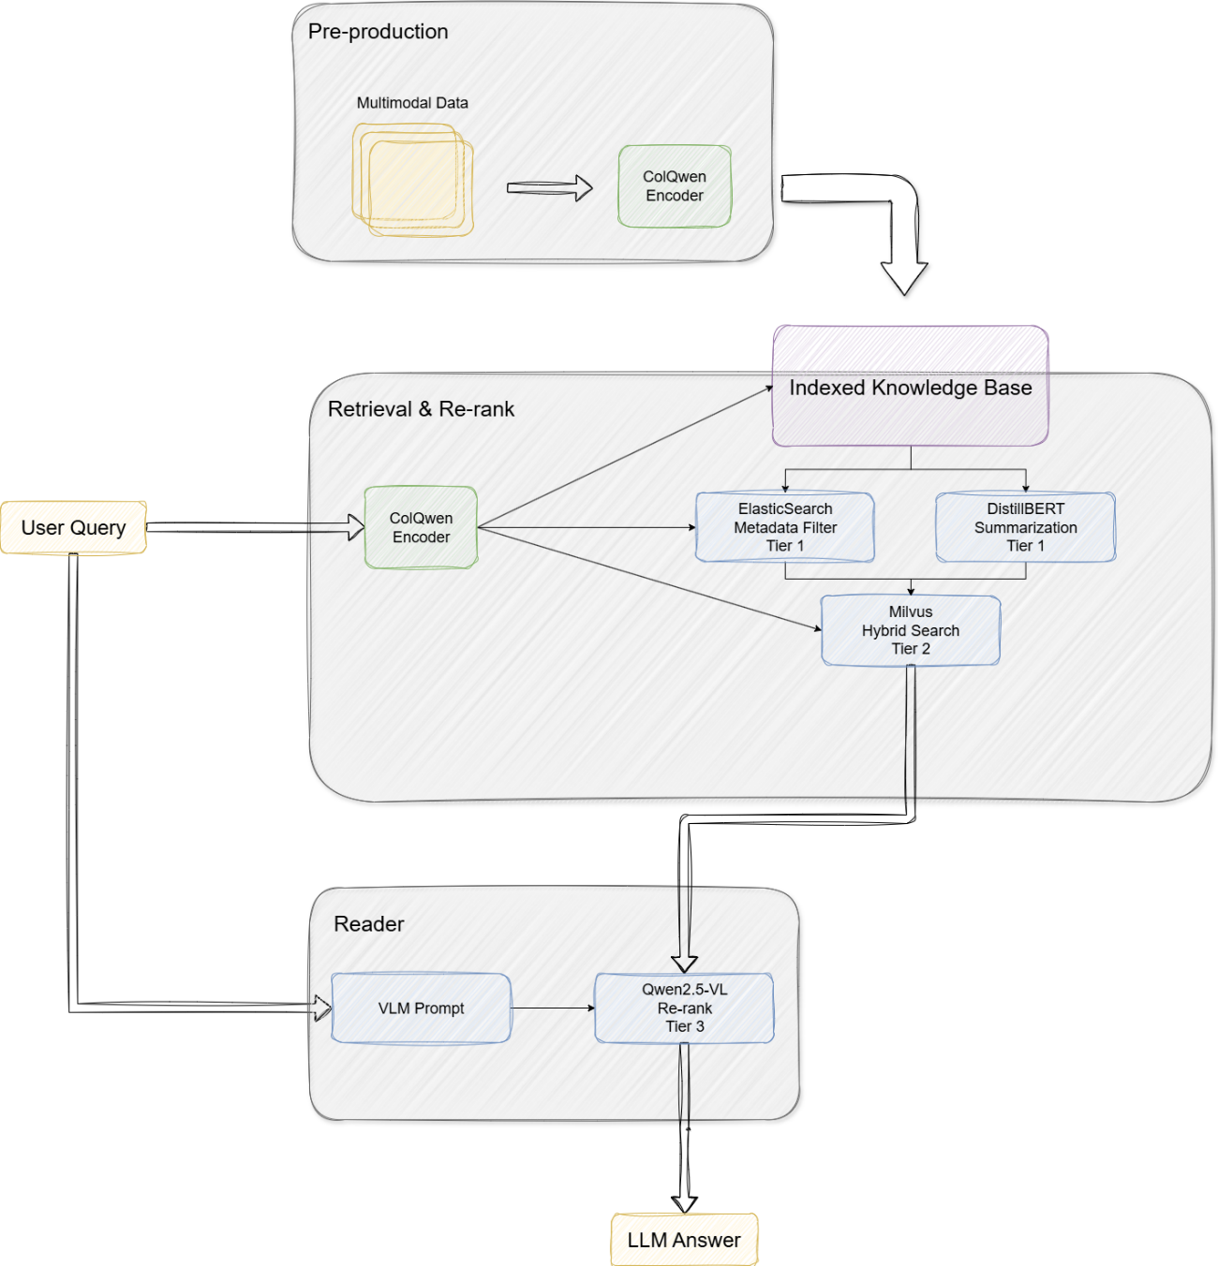
Industry Experience 1
User Input: Query + Doc
Embedding: Token-level/patch-level vector
Tier 1
Meta Filter: keywords, timestamp, partition, etc
Summarization: offline doc text summarization
Tier 2
Late Interaction
Hybrid Search: HNSW+IVF-Q
Tier 3
Qwen-VL: image understanding + score

Slide 22
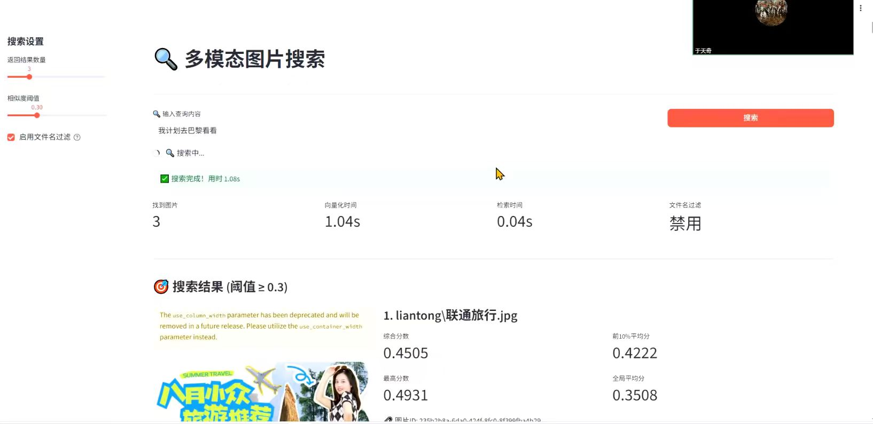
Industry Experience 1
Compared to traditional solution:
Recall@10: 27% Improved
nDCG@10: 13% Improved
Average latency: 35% Saved
In financial Auditing/industrial maintenance: (compare to ColPali 8% Recall Improved)

Slide 23
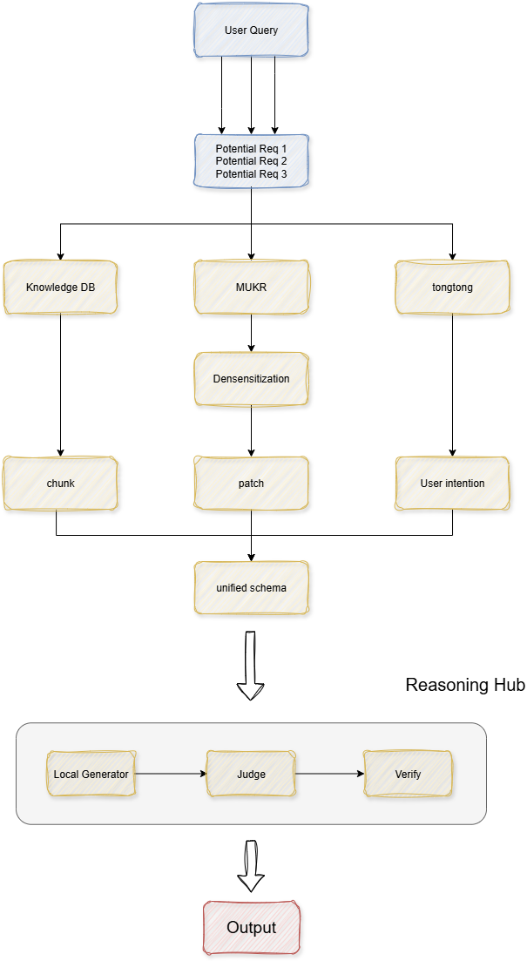
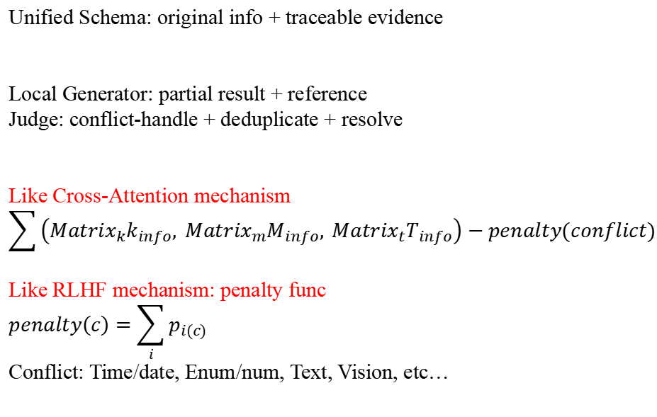
Industry Experience 1
Unified Schema: original info + traceable evidence
Local Generator: partial result + reference
Judge: conflict-handle + deduplicate + resolve
Like Cross-Attention mechanism
$$\sum{\left({Matrix}_{k}k_{info}, {Matrix}_{m}M_{info}, {Matrix}_{t}T_{info}\right)−penalty(conflict)}$$
Like RLHF mechanism: penalty func
$$penalty\left(c\right)=\sum_{i}{p_{i(c)}}$$
Conflict: Time/date, Enum/num, Text, Vision, etc…

Slide 24
Industry Experience 2
Multi-intention Recognition: semi-supervise learning and small-parameter LLM
What we do?
Built a multi-intent recognition pipeline, incorporating modules include small-parameter LLM, RAG, classification, etc
Conducted a standard data engineering pipeline, involving in deduplication, LLM-instruction format, regrex, desensitization
Involved in data engineering, system design, log module design, training of NLP classification model
Why we do this?
Navigation sytem in a mobile APP
Technical validation for small-parameter LLM
Verification of previous work, such as research project 1 and others
Any obstacles?
Too many
High precision & latency requirements, limited resources
Data Quality, mainly generated by LLM, not align with actual data distribution
Few time, and complex responsibility allocation across departments

Slide 25
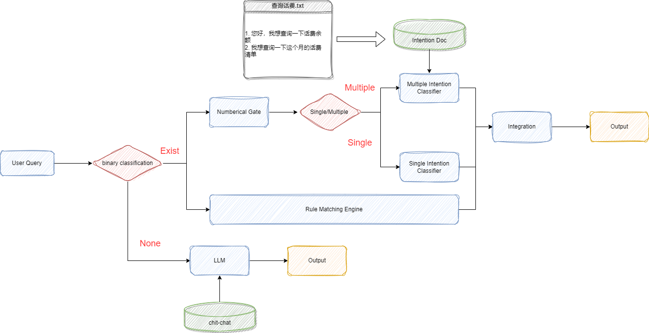
Industry Experience 2
Rivals
1. Qwen72B+Agent workflow
2. top-10+Qwen32B

Slide 26
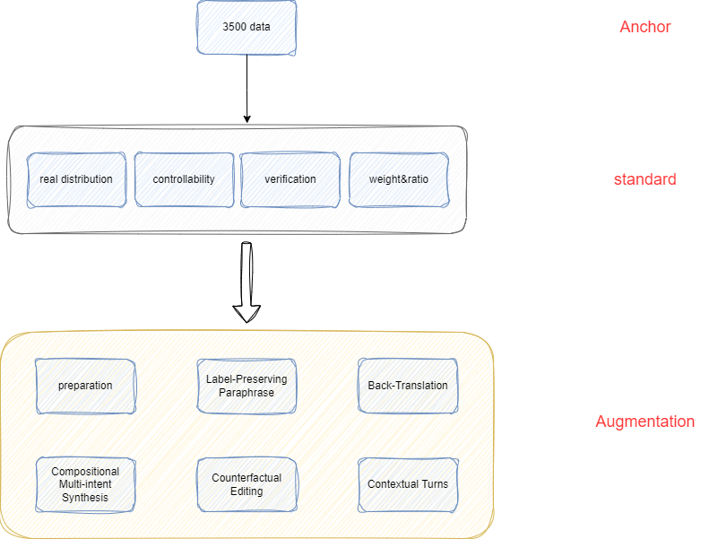
Industry Experience 2
Main Problem
Fully depends on data, if compare to LLM + Agent workflow
But this project is REALLY lack of data
Industrial data is differentiate, 31+4 divisions have their own categories
Preparation
keywords, mutual exclusive, strong-correlated
LPP: oral, language domain
BT: ch -> en -> ch
CMIS: combine multiple high-correlated single
CE; replace different entity in slot
CT: construct multi-turn history

Slide 27
Future Research Interests
1. Efficient Knowledge Retrieval for Large Language Models
2. Vector Databases and Multimodal Information Integration
3. Scalability and Efficiency in Large Language Models Inference & Deployment

Slide 28
Q&A

